Slide 1

Domestic Violence Awareness
Project HELP Scholars 2020
Amber Moore, Tekedra Rolling Epps, Adrian Day, Christie Caves

Slide 2


Slide 3





Slide 4
Facts
Domestic violence can be physical, sexual, verbal, or psychological.
Victims of domestic violence are diverse. They can be educated, uneducated, poor, wealthy, and from any ethnic background.
Domestic Violence can also occur between same-sex and heterosexual couples.

Slide 5

Nationwide Domestic Violence
On average, nearly 20 people per minute are physically abused by an intimate partner in the United States.
1 in 3 women and 1 and 4 men have experienced some form of physical violence by an intimate partner.
On a normal day, domestic violence hotlines receive about 21,000 calls which is approximately 15 calls every minute.
Intimate partner violence accounts for 15% of all violent crimes.
72% of all murder-suicides involved an intimate partner, and 94% of he victims are female.
Only 34% of victims receive medical care for their injuries.

Slide 6
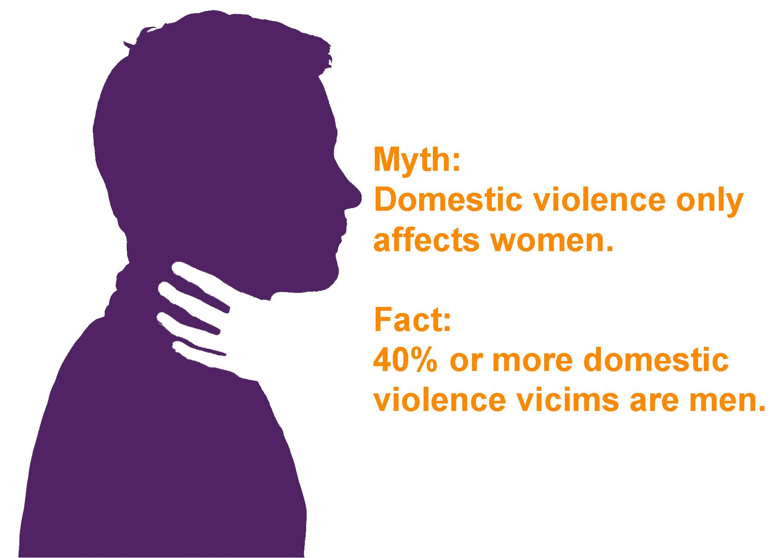

Slide 7
Domestic Violence in Mississippi
On September 14, 2014, Mississippi domestic violence shelters reported the following services in a 24-hour period
  393 domestic violence victims (197 children and 196 adults) found refuge in emergency shelters or transitional housing provided by local domestic violence programs.
  72 adults and children received non-residential assistance and services, including counseling, legal advocacy, and children’s support groups.
  In the 24-hour survey period, local and state hotlines answered 181 calls, averaging more than 7 hotline calls every hour.

Slide 8

Costs of Domestic Violence
Victims of domestic violence lose a total of 8 million days of paid work each year.
The cost of intimate partner violence exceeds $8.3 billion per year.
Between 21-60% of victims of domestic violence lose their jobs due to reasons resulting from the abuse.

Slide 9
Physical/ Mental Health Impact
Women abused by their intimate partners are more susceptible to contracting HIV or other sexually transmitted infections/diseases due to forced intercourse or continued exposure to stress.
Studies suggest that there is a relationship between domestic violence and depression and suicidal behavior.
Physical, mental, and sexual/reproductive health effects have been linked with domestic violence which includes unintended pregnancy , miscarriage, neurological disorders, anxiety, post-traumatic stress disorder, etc.
Victims of domestic violence are at higher risk for developing addictions to alcohol, tobacco, or drugs.

Slide 10

Children Exposed to Domestic Violence
Each year 1 in 15 children are exposed to domestic violence, and 90% of them are eyewitnesses to the violence.
Children exposed to domestic violence can experience emotional, mental, and social damage that can affect their developmental growth.

Slide 11


Slide 12

Guns & Violence Against Women
Every month, there is an average of 53 women being shot and killed by an intimate partner.
In 2015, 92% of all women killed with guns were from the United States.
Access to a gun makes it five times more likely that the abusive partner will kill the female victim.
Black women are twice as likely to be fatally shot by an intimate partner compared to white women.
One in three Hispanic women have experienced domestic violence by an intimate partner in their lifetimes.

Slide 13
Domestic Violence in Women and Children
1 in 3 women experience some form of domestic violence in their lifetime(Black et al., 2011, as cited in Herschel et al., 2017).
1 in 4 children experience family violence during their lifetime, with at least 90% of those children witnessing that violence between their primary caregivers (Hamby et al., 2011, as cited in Herschel et al., 2017).
Domestic violence not only affects the people in the primary relationship, but those surrounding that relationship such as children within the home where the violence takes place (Vargas et al., 2005).

Slide 14
Parent-Child Interaction Therapy (PCIT) As Treatment for Victims of Domestic Violence
A study was conducted on the feasibility and effectiveness of PCIT as a form of treatment for victims of domestic violence (Herschel et al., 2017).
The study included a total of 21 children and their parent(s), that have been a victim of domestic violence, directly or indirectly (Herschel et al., 2017).
Of those 21 children, only 43% completed the study (Herschel et al., 2016).
Those that did complete the study, completed with positive results (Herschel et al., 2017).
The effectiveness of treatment was based on the child’s behavior, their parents parenting practices, and their mental health functioning (Herschel et al., 2017).

Slide 15
Parent-Child Interaction Therapy (PCIT) As Treatment for Victims of Domestic Violence Cont…
After the PCIT treatment, the problematic child’s behavior improved drastically, resulting in the child’s behavior reverting to normal (Herschel et al., 2017).
The Eyeburg Child Behavior Inventory (ECBI) Intensity and Problem Scales were administered as a form of assessment and the scores showed clinical and statistical behavioral improvements (Herschel et al., 2017).
Assessment measures are imperative in treating children who have been exposed to domestic violence because the therapist is able to evaluate the child on different social interaction levels (Vargas et al., 2005).

Slide 16
What can I do???
STAND up to Domestic Violence
→ Speak up if you hear excuses for violence or victim blaming
→ Treat your partner with respect
→ Always challenge abusive behaviors
→ Never assume they’ll be okay
→ Direct, Distract, Delegate or Delay
Notes:
According to the Mississippi Coalition against Domestic violence, we have a responsibility to keep our communities safe. Your silence is a form of consent and complicity. https://mcadv.org

Slide 17
Domestic Violence Programs in Mississippi
1st Congressional District
Safe Haven, Inc.
Columbus
662.327.6118
Shelter & Assistance in Family Emergencies
Tupelo
601.841.9138
SAFE
Tupelo
662.841.2273
House of Grace
Southaven
662.342.1432
2nd Congressional District
Haven House Family Shelter
Vicksburg
601.638.0555
Our House, Inc.
Greenville
662.332.5683
The Center for Violence Prevention
Vicksburg –
601.932.4198
Notes:
NCADV.(2015). Domestic violence national statistics. Retrieved from www.ncadv.org

Slide 18
Domestic Violence Programs in Mississippi
3rd Congressional District
Care Lodge Domestic Violence Shelter
Meridian
601.482.8719
Catholic Charities The Guardian Shelter for Battered Families
Natchez
601.442.4579
Catholic Charities Shelter for Battered Families
Jackson
601.355.8634
W.I.N.G.S.
McComb
601.684.9225
Angel Wings Outreach Center
Mendenhall
601.847.5802
Center for Violence Prevention
Pearl
601.932.4198
Notes:
NCADV.(2015).Domestic violence national statistics. Retrieved from www.ncadv.org

Slide 19
Domestic Violence Programs in Mississippi
4th Congressional District
Gulf Coast Women's Center For Nonviolence
Biloxi
228.435.1968
Adrienne's House
Gulf Coast Women's Center for Nonviolence
Pascagoula
228.205.4502
Notes:
NCADV.(2015). Domestic violence national statistics. Retrieved from www.ncadv.org

Slide 20
Need Help??
The National Domestic Violence Hotline
1-800-799-SAFE(7233)
State of Mississippi Hotline
1-800-898-3234
Or
DomesticShelters.org

Slide 21
References
Herschell, A., Scudder, A., Schaffner, K., & Slagel, L. (2017). Feasibility and effectiveness of parent-child interaction therapy with victims of domestic violence: A pilot study. Journal of Child & Family Studies, 26(1), 271–283. https://ecnhts-proxy.jsums.edu:3569/10.1007/s10826-016-0546-y
Vargas, L. Cataldo, J., & Dickson, S. (2005). Domestic violence and children. In G. R. Walz & R. K. Yep (Eds.), VISTAS: Compelling perspectives on counseling, 2005 (pp.67- 69). Alexandria, VA: American Counseling Association.
National Coalition Against Domestic Violence
  https://ncadv.org/statistics
  https://assets.speakcdn.com/assets/2497/mississippi_2019.pdf
Guns and Violence Against Women
  https://everytownresearch.org/report/guns-and-violence-against-women-americas-uniquely-lethal-intimate-partner-violence-problem/

