Slide 1
Empowerment through knowledge and engagement – understanding the NSF processes
Session One – NSF Grants 101
May 23, 2018
11:00 am – 12:00 pm EST

Slide 2
Introductions
Clytrice Watson, Program Officer of the HBCU-UP Program, Education and Human Resource Directorate, Division of Human Resource Development (EHR/HRD)
Rashawn Farrior, Team Lead, Education and Human Resources Directorate (EHR)
Jannele Gosey, Grants Management Specialist for the Division of Undergraduate Education (DUE) and the Division of Human Resource Development (HRD)

Slide 3
agenda
What is the National Science Foundation?
Statistics
Proposal & Award Policies and Procedures Guide (PAPPG)
Roles and Relationships
New Awardee/Updated Performer Information
Delay of Award
Indirect Costs and Calculations
Notification of Award
Pathways to Success
Q & A

Slide 4
What is the national science foundation?
The National Science Foundation (NSF) is an independent federal agency created by Congress in 1950 "to promote the progress of science; to advance the national health, prosperity, and welfare; to secure the national defense..." NSF is vital because we support basic research and people to create knowledge that transforms the future. This type of support:
Is a primary driver of the U.S. economy
Enhances the nation's security
Advances knowledge to sustain global leadership
With an annual budget of $7.8 billion (FY 2018), we are the funding source for approximately 27 percent of the total federal budget for basic research conducted at U.S. colleges and universities. In many fields such as mathematics, computer science and the social sciences, NSF is the major source of federal backing.

Slide 5
NSF is located at 2415 Eisenhower Avenue, Alexandria VA 22314
The NSF is organized into:
2 Offices → 9 Divisions
7 Directorates → 32 Divisions
For a complete listing of the Directorates and Divisions please visit www.nsf.gov
The National Science Board oversees the NSF.

Slide 6
Statistics – Fiscal year 2017

Slide 7
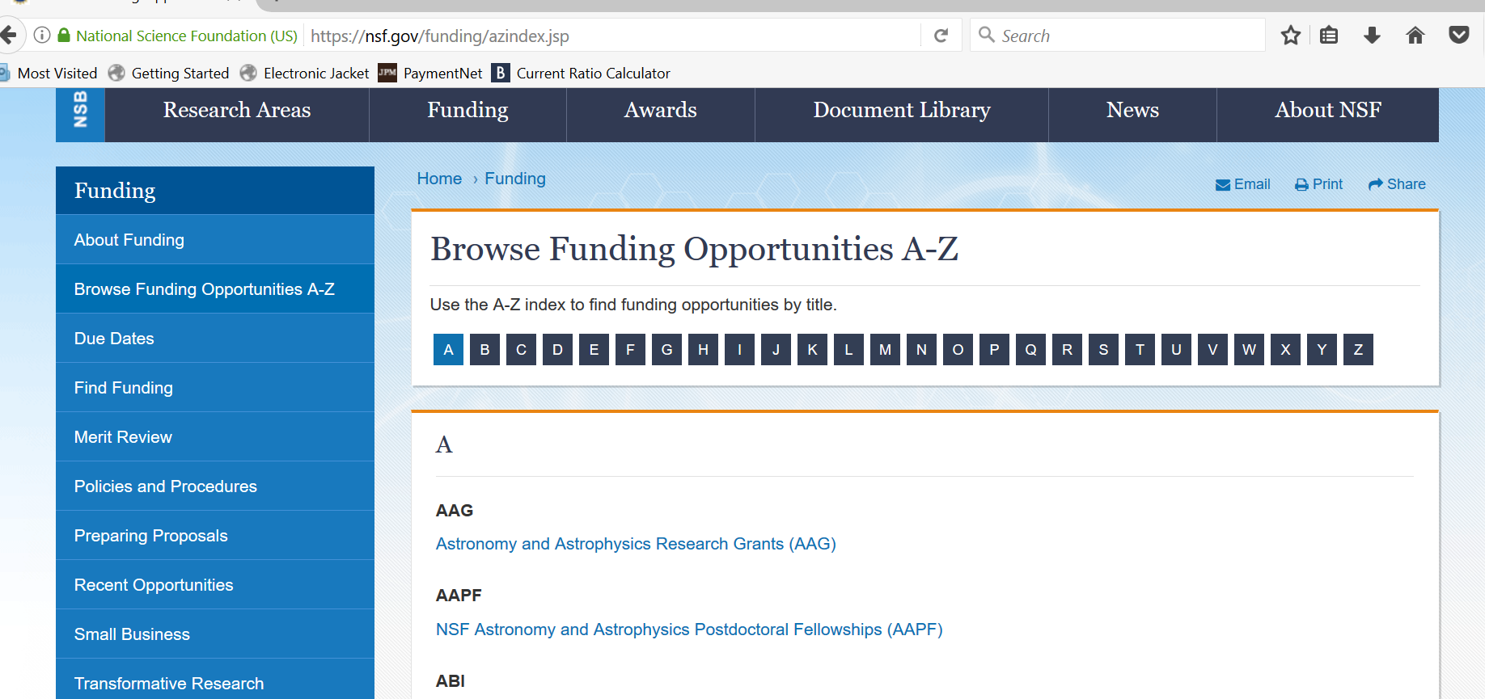

Slide 8
Proposal & Award Policies and Procedures guide NSF 18-1

Slide 9
What is your role?
Principal Investigator (PI) – means the individual(s) designated by the proposer, and approved by NSF, who will be responsible for the scientific or technical direction of the project. The PI and any identified Co-PIs, however, will be jointly responsible for submission of the requisite project reports.
Program Officer (PO) – The NSF program officer reviews the proposal and analyzes the input received from the external reviewers. After scientific, technical and programmatic review and consideration of appropriate factors, the program officer makes an "award" or "decline" recommendation to the division director
Grants Management Specialist/Grants Officer – A DGA officer reviews the recommendation from the program division/office for business, financial and policy implications, and the processing and issuance of a grant or cooperative agreement. DGA generally makes awards to academic institutions within 30 days after the program division/office makes its recommendation.
Office of Sponsored Research (OSP)/ Sponsored Research Officer (SPO) - Full responsibility for the conduct of project activity and for adhering to the award conditions. Must ensure that the institution is in compliance to all applicable Federal requirements and to manage all expenditures and actions prudently. And also ensures that expenditures are allowable, allocable, and reasonable.

Slide 10
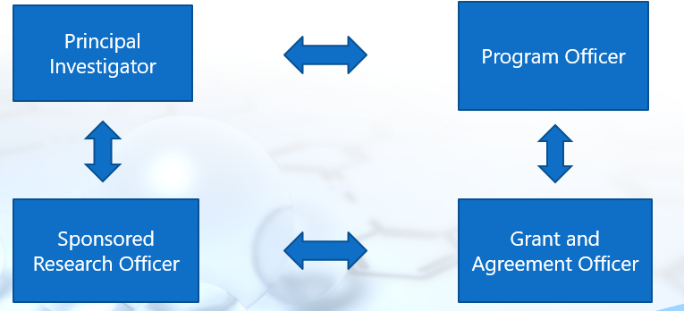
Working relationships

Slide 11
Division of grants and agreements (dga)
What Kind of Awards are Issued by DGA?
Assistance Awards - the principal purpose of which is to transfer anything of value from NSF to the grantee for them to carry out a public purpose; and not to acquire property or services for NSF’s direct benefit or use.
Grants (Standard and Continuing)
Cooperative Agreements
Fellowships
How Many Actions Does DGA Process?
DGA typically approves approximately 17,000 funded actions, and 4,000 non-funded actions each year.

Slide 12
Dga’s role in the award process

Slide 13
New awardee and updated performer information
New Awardee – A new awardee is an institution (the award is made to the institution, not the PI) that has never received an NSF grant award.
Before an NSF award is made to a New Awardee institution, a review is completed by DGA (if awarded amount will be $225K or under) or NSF’s Cost Analysis and Pre Award Branch (CAAP) (if awarded is over $225K) to verify the accounting system capability and the institution’s financial viability to be able to handle the federal funding.
Updated Performer – An institution that has received NSF awards, but hasn’t had an award in 5 years (end date of last award).

Slide 14
New awardee/updated performer package
The New Awardee/Updated Performer Package will be requested from the Office of Sponsored Research in the form of an email and the required documents are to be returned within 15 days.
Examples of information requested are:
Copy of the Project Cost Ledger
Institutions policies and procedures on Participant Support, Allowability of Costs and Subawards
Last 2 years of financial statements
Once your information is received, it can take up to 60 days for the CAAP decision to be made.

Slide 15
The DGA Review Process – items that WILL delay processing
Federally Negotiated Indirect Cost Rate (NICRA) – Upon completing your budget, you must use your current NICRA for your institution and any subawards.
If you or your subaward doesn’t not have a rate, you (they) can use the 10% de minimis rate (Modified Total Direct Cost).
Budget and Justification Issues – Unallowable costs usually found in Budget Line Items F. Participant Support and G. 6. Other Direct Costs that aren’t fully described in the budget justification.
Institutional Review Board (IRB) Approval Documentation – This documentation NEEDS to be submitted before the Proposal can receive funding.

Slide 16
Indirect cost calculation
Please understand the terms of your NICRA, as it explains what your rate is along with the base.
Base – Salaries and Wages; Salaries, Wages, and Fringe Benefits; or Modified Total Direct Costs (MTDC).
If your base is Salaries and Wages and your indirect cost rate is 35%. Then you would simply multiply the total for Salaries and Wages by 35% and the answer is the indirect cost amount.
If your base is Salaries, Wages, and Fringe Benefits and your indirect cost rate is 35%. Then you would simply multiply the total for Salaries, Wages, and Fringe Benefits by 35% and the answer is the indirect cost amount.

Slide 17
Indirect cost calculation – modified total direct costs (mtdc)
If you have a MTDC base rate agreement – you must exclude:
participant support
equipment in excess of $5,000
you will pay indirect costs for subawards the first $25K of each subaward (regardless of the length of the award), the remaining amount is excluded
Tuition
May be other exclusions, please refer to your rate agreement

Slide 18
Sample mtdc indirect cost calculation
You have been awarded a 5 year grant with the following details:
Indirect Cost rate is 45%, Equipment costs $20K, 2 subawards (1 for 100K and the other for $30K), Participant Support Costs $150K, and tuition costs (not participant support) $30K.
Your current total direct costs on your budget (prior to calculation) is at $1M.
Total direct costs - $1M
Subtract equipment ($20K)
Subtract subaward excess ($80K)
Subtract participant support (150K)
Subtract tuition costs ($30K)
$720,000 X 45% = $324,000 (indirect cost amount)

Slide 19
Notification of award
Award Letter by email
Solicitation 16 – 538
Research Terms and Conditions (RTCs), occasional special conditions, and other documents incorporated by reference

Slide 20
Pathways to success!
Focus on the objectives of the project/program;
Effective communication between everyone involved;
Good accounting practices;
Official records

Slide 21
CONTACT INFORMATION
Jannele Gosey, jgosey@nsf.gov, 703-292-4445

Slide 22
ASK EARLY, ASK OFTEN!

