Slide 1
Empowerment through knowledge and engagement – understanding the NSF processes
Session Three – Post Award Management
May 25, 2018
11:00 am – 12:00 pm EST

Slide 2
Introductions
Clytrice Watson, Program Officer of the HBCU-UP Program, Education and Human Resource Directorate, Division of Human Resource Development (EHR/HRD)
Jannele Gosey, Grants Management Specialist for the Division of Undergraduate Education (DUE) and the Division of Human Resource Development (HRD)
Rashawn Farrior, Team Lead, Education and Human Resources Directorate (EHR)

Slide 3
agenda
Prior Approvals
Re-Budgeting Authority
No Cost Extensions
Reporting Requirements
Site Visit Information
Pathways to Success
Resources
Q & A

Slide 4
Prior approvals

Slide 7
Re-budgeting authority
NSF allows the institutions total budget reallocation authority. However, you must adhere to your institution’s policies and procedures.
You do NOT have to request permission from NSF to make budget changes unless:
Funding needs to be moved OUT of the Participant Support Costs Category.
OR
The change would result in a change of scope or objective.
*If either situation were to arise, permission from the Program Officer is needed and the request can be made through Fastlane.

Slide 8
No cost extension (nce)

Slide 9
Reporting requirements

Slide 10
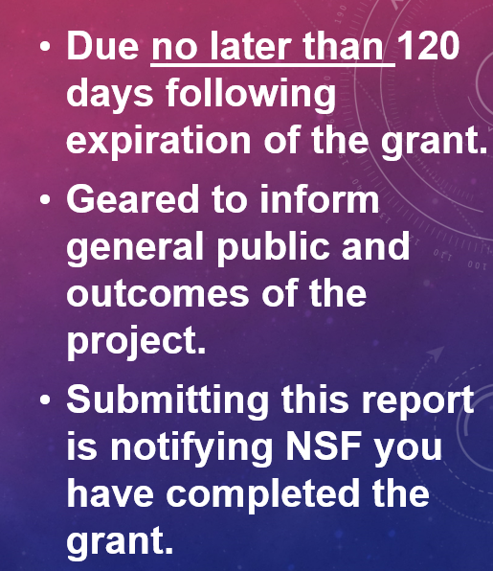
Project outcomes report
Do not submit this report if you intend to request a NCE. Submission of this report states that the project is done and the system will initiate the financial and administrative closing of the award.

Slide 11
Advanced monitoring site visit
Site visits are one of several monitoring tools used by the Office of Budget, Finance and Award Management (BFA) Division to provide oversight of NSF’s research award portfolio.
The Division of Institute and Award Support (DIAS) uses an risk assessment algorithm to develop the list of institutions that will receive an Advanced Monitoring Site Visit for that year. 30 visits are done each year either in person or virtually, by a Cost Analyst from DIAS and a Grants Management Specialist from DGA.
This is a business assistance visit and not an audit. We review your time and effort systems, accounting systems and also review your policies and procedures to make sure that you are in compliance with Federal guidelines and regulations.
Being prepared prior to the site visit always helps thing run smoother.

Slide 12
Pathways to success!
Policies and Procedures;
Effective communication between everyone involved;
Official records;
Good accounting practices

Slide 13
Resources Proposal & Award Policies and Procedures guide NSF 18-1

Slide 16
CONTACT INFORMATION
Jannele Gosey, jgosey@nsf.gov, 703-292-4445

Slide 17
ASK EARLY, ASK OFTEN!

