Slide 1

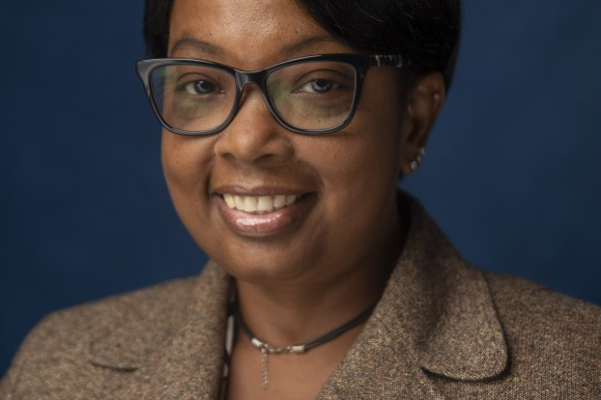
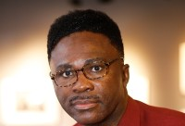
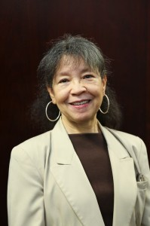
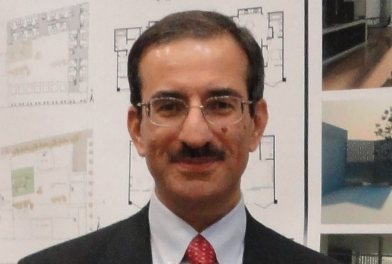
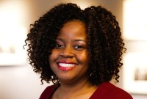
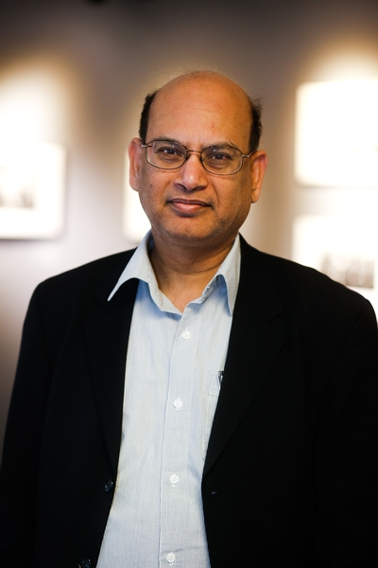
Full-time Faculty & Areas of Expertise/Interest
Berneece S. Herbert, Ph.D.
Associate Professor & Chair
Berneece.Herbert@jsums.edu
Urban Structure & Sustainability
Food Security & Under-resourced Communities
Climate Change & Energy Justice
Edmund Merem, Ph.D.
Professor
edmund.c.merem@jsums.edu
Planning Ethics
Global Cities & International Development
Climate Change, Environment & Land Use
Joan M. Wesley, Ph.D.
Associate Professor (Retired)
joan.m.wesley@jsums.edu
Community Development & Housing
Stakeholder Participation & Community Engagement
Social Equity & Environmental Justice
Firas Al-Douri, Ph.D.
Associate Professor
firas.a.aldouri@jsums.edu
Urban Design Theory & practice
Contemporary & Sustainable Urbanism
Information Technology in Urban Design
Talya Thomas, Ph.D.
Associate Professor
talya.d.thomas@jsums.edu
Community Development & Housing
Environmental & Public Policy
Food Security
Moe Chowdhury, Ph.D., AICP
Visiting Assistant Professor
moe.n.chowdhury@jsums.edu
Urban Studies
Transportation Planning
Human Geography

Slide 2

Selected Partners
The Department of Urban & Regional Planning @
CREW @ Ole Miss
One Voice
South Delta Planning & Development District
HBCU Sustainable Communities Initiative
University of Louisiana, Lafayette
Food Systems & Community Health
Social Innovation, Equity & Community Engagement
Jobs to Move America
Maritime Transportation Research & Education Center
Clean Energy States Alliance
Jackson Redevelopment Authority
Key Themes
Healthy, Equitable, Inclusive, Resilient & Smart (HEIRS) Communities
FEMA
MSU – Jackson Community Design Center
Housing, Smart Infrastructure & Urban Form
Climate Change & Environmental Justice
NEOO Partners Inc
UC Berkeley, Dept of Environment Planning & Landscape Architecture
Deep South Center for Environmental Justice
Economic Development & Globalization
Jackson Public Schools
2C Mississippi
Cornell University, School of Industrial and Labor Relations
Climate Resilience Center
Jobs with Justice

Slide 3




current Research projects Berneece S. Herbert, PhD
Herbert, B (PI): Advancing Black Workers in the South: An HBCU Research Initiative. Partner Organizations: Center for Economic and Policy Research, Cornell University, Clinton College, Clark Atlanta University, Norfolk State University, University of Texas at Arlington.
The primary goal of this project is to improve the research capacity at HBCU's and other Minority Serving Institutions to study Black workers and Black worker organizing in the South. Using a combination of worker surveys and community surveys the research will examine which worker and community issues and characteristics, employer practices, and union and employer strategies have the greatest impact on the power, voice, representation, and economic mobility of Black workers in the South. The project is funded by the Jobs With Justice Education Fund. The project period is February 2024 – January 2026
Herbert, B (PI). Enhancing sustainability and landscape connectivity through the design of a conceptual multifunctional urban green corridor system in Jackson MS
The purpose of this project is to propose a conceptual design of a multifunctional urban green corridor system in Jackson Mississippi to enhance urban sustainability and landscape connectivity. An ecological connectivity pattern analysis will quantify the relationship between the land use/cover types and the availability of land for trails and corridors. The analysis will focus efforts to identify and conserve areas that facilitate movement and enhance connectivity as part of effective, landscape-scale corridor development while also helping to identify and prioritize actions that have the most benefit to biodiversity and ecosystem functioning. The project is funded through the HBCU Sustainable Community Initiative supported by UNCF, INROADS and the Thurgood Marshall Fund. The project period is January 2024 – August 2024
Herbert, B (Sub-Contract): Micro Parks System: Building Resilience to Climate Disasters in Jackson, MS
The purpose of this project is to assess the use of selected vacant lots, abandoned and dilapidated properties to be transformed into a system of micro-parks as a nature-based solution for flood mitigation in the City of Jackson. Funding was obtained through 2C Mississippi and the Hilton Foundation. The project period is December 2023 – November 2024.

Slide 4
current Research projects Berneece S. Herbert, PhD
Herbert, B (PI). (March 2024). Assessing Maritime Infrastructure along the Mississippi: Chokepoints and Implications for Food Security. MarTREC, University of Arkansas. https://zenodo.org/doi/10.5281/zenodo.10647494
The Mississippi River is a major part of the MTS and has been referred to as ‘America’s inland hydro highway’. It is a critical food security corridor functioning as a major trading thoroughfare for US goods and commodities to and from the rest of the world. The pressure and strain on the water transport infrastructure along the Mississippi river is a serious and urgent issue that requires attention and action from policymakers, stakeholders, and researchers. The purpose of this project is to evaluate the benefits and climate vulnerabilities of the Maritime transportation system, focusing on port infrastructure, agricultural trade, and resiliency. The Port of New Orleans is used as the study site. The project period was November 2021 – June 2023
RECENT PROJECTS
Erickson, E and Herbert, B. (February 2023). Job Quality and Community Well-Being in Mississippi and Alabama’s Manufacturing Facilities. Funded by Jobs to Move America. https://jobstomoveamerica.org/resource/job-quality-and-community-well-being-in-mississippi-and-alabamas-manufacturing-facilities/
The research attempted to shed light on the lived experiences of manufacturing workers in Mississippi and Alabama to better understand the impact that manufacturing facilities have on local individuals, communities, and economies. The report investigates a range of attributes or measurable dimensions of job quality through the analysis of data collected from more than 1,300 employees at manufacturing facilities. These dimensions are assembled into a job quality assessment framework, and then used to assess the overall quality of jobs offered by the two-state region’s manufacturing sector. The project period was February 2022 – February 2023.

Slide 5
current Research projects
Firas Al Douri, PhD
Urban Cooling Strategies for Mitigating Heat Exposure to Enhance Community Resilience Background, Spring Break Extreme Project: Collaborative work with Dr. Rocky Talchabhadel and Dr. Yadong Li, Jackson State University, 02-05/2024
The research project is intended to examine how natural solutions such as parks and water features, can help cool down neighborhoods where people are most at risk.
Using AI in Developing Urban Design Plans: Techniques and Implementation & Enhancing Urban Sustainability using Parametric Modeling and Generative Design Tools
These are two exploratory case studies in two global architecture firms. The objective is twofold: i) Examining the methods and techniques of using AI in urban design practice; ii) Assessment of their impact on the urban sustainability of the urban form
Outcomes: one conference paper in ARCC/EAAE 2024 (Accepted); One conference paper in eCAADe 2024 (submitted in January 2024, accepted), and one journal article in Ekistics (proposal submitted in January 2024; Accepted in March 2024, pending final review).
CampuSIM: A Simulation and Optimization Model for Campus Design Decision-Support. Collaborative work with Dr. Wei Yan, Texas A&M University. 09/2022-08/2023
This is exploratory research. The objective is twofold: i) Constructing and implementing our campus design optimization model; ii) Examining the impact of the characteristics of the campus environment on students' movement patterns, transportation, and walking behaviors; iii) Applying the simulations in a wide range of normal and emergency scenarios of complex, dynamic pedestrian behavior to support design processes and decision-making.
Outcomes: one conference paper published in CAADRIA 2023 Conference proceedings.

Slide 6
current Research projects
Firas Al Douri, PhD
The Usage of Digital Technologies in Urban Design Practice in US Cities; does it help shaping a sustainable urban form? A case study of the city of Seattle, WA.
This is a single case study mixed-method research. The research objective is twofold: i) Investigate how and at what phases planning professionals use simulation techniques; ii) How has the usage of those techniques supported planning professionals in a) Developing a city-wide design strategy across both micro and macro scales and b) Addressing various aspects of sustainability of the urban form.
Outcomes: Work in progress; One journal article (work in progress), and one paper submitted in January 2024 to the Simulation in Architecture and Urban Design (SimAUD) Symposium 2024 (under review).
Digital Twins: A shift to a new urban planning paradigm. Collaborative work with Dr. Thomas Sanchez, Texas A&M University. 03/2024
This is an exploratory research study in the initial phase. The objective is twofold: i) Investigate how could Digital Twins increase the efficiency of urban plans in addressing contemporary challenges and achieving urban sustainability; ii) How could it revolutionize urban design professional practice and research.

Slide 7




Al-Douri, F; Yan, W; and Jahic, E. (2023) An Integrated Parametric BIM for Campus Design Simulation and Optimization, in Immanuel Koh, Dagmar Reinhardt, Mohammed Makki, Mona Khakhar, Nic Bao (eds.), HUMAN-CENTRIC - Proceedings of the 28th CAADRIA Conference, Ahmedabad, 18-24 March 2023, pp. 471–480, https://doi.org/10.52842/conf.caadria.2023.2.471
Al-Douri, F (2024-forthcoming) Integrated BIM+Parametric Modeling: A Decision-support Tool for Inclusive Open Space Simulation, Automation, and Optimization, Ekistics and the New Habitat: Human Centered Planning and Design; Themed Issue, (Proposal submitted in January 2024; Accepted in March 2024; pending final review).
Al-Douri, F, (2024-forthcoming) Enhancing Urban Sustainability Using Generative Design Tools; The case study of Hangzhou Masterplan, China, in Data-Driven Intelligence, Proceedings of the 42nd Education and Research in Computer Aided Architectural Design in Europe, 9-13 September 2024-Nicosia, Cyprus.
Al-Douri, F, (2024: forthcoming) Simulation and Visualization Tools: How do they support designing a sustainable urban form? In Symposium on Simulation for Architecture and Urban Design (SimAUD) 2024,May 20-23, 2024, American University, Washington D.C., USA, (Manuscript submitted in January 2024; Accepted in March 2024; pending final review)
Al-Douri, F. (2024: forthcoming) Enhancing Urban Sustainability Using Parametric Modeling and Generative Design Tools, in EAAE/ARCC Conference 2024, Architecture Into the Unknown, 23-26 May 2024, Aarhus, Denmark (Accepted)
Al-Douri, F (Forthcoming) “The Content of Urban Design Plans in US City Centers; Does it shape a city-wide Design Strategy?” to be submitted to URBAN DESIGN International Journal (UDI).
Al-Douri, F (Forthcoming) “Urban Design Plans in US City-Centers; How do they respond to the contemporary urban challenges? to be submitted to the Journal of Urban Design &Planning.
PUBLICATIONS

Slide 8
Merem, E. C. (2024 January). Analyzing Water Resource Challenges in the US Eastern Zone. Marine Science. 1:1
Merem, E. C. (2024 January). Exploring Shifts in Yam Production Trends In Nigeria’s Southern Region. International Journal of Food Science and Nutrition Engineering. 14:1
Merem, E. C. (2024 January). Analyzing The Capacities of Cotton Production In Sudan. International Journal of Agriculture and Forestry. 14:1
Merem, E. C. (2024 January). Investigating The Ecological Effects of Agricultural Assistance Schemes In California's Central Valley Area. Food and Public Health. 14:1.
Merem, E. C. (2024 January). The Effects of Changing Climate In The US Western Region. International Journal of Ecosystem.13:1
Merem, E. C. (January 2024). The Analysis of Extreme Climate Threats In Maryland’s Lower Region. World Environment. 14:1
Merem, E. C. (2024 January). Assessing The consequences of Climate Change Dangers in the South Florida Region. Resources and Environment. 14:1
Merem, E. C. (2024 January). Evaluating Climate Change Hazards Within the Midwest Zone. American Journal of Environmental Engineering. 14:1
Books In Print and Under Production:
Merem, E. C. (2024). The Anthology of American Environmental history. Pittsburgh, PA: Dorrance Press.
PUBLICATIONS

Slide 9
Merem, E. C. (2024 March). “Assessing Cotton Production Potentials in Nigeria’s Northern Region,” Conference Paper Presented at 32nd Joint Conference of National Association of African American Studies (NAAAS). Arlington, TX. February 15-17, 2024.
Merem, E. C. (2024 March). Assessing Solar Energy Potentials in Nigeria. Paper Abstract Accepted for Presentation at the 33rd Annual International (West Coast) Conference on Soil, Water, Energy, and Air (AEHS). San Diego, CA. March 19-21, 2024.
Merem, E. C. (2024 March). Analyzing Sheanuts Land Use In Nigeria. Abstract Presented At the Conference of Minority Public Administrators (COMPA). New Orleans, LA February 26, 2024.
Merem, E. C. (2024 March). The Analysis of Water Resources Management Issues In South Africa. Abstract Submitted for the 97th Annual Louisiana Academy of Science Conference. University of Southeastern Louisiana Hammond, LA. March 23, 2024.
Merem, E. C. (2024 May). Examining Geothermal Energy Capacities. In the Northeast Africa Region. The Case of Ethiopia. Abstract Submitted For the Mid South American Society For Photogrammetry and Remote Sensing (ASPRS) Conference. Oakridge, TN. May 4th, 2024.
Merem, E. C. (2024 March). Examining Geothermal Energy Capacities. In Western Canada Region. Paper Presented At the Alabama A&M University Climate Change Conference .Huntsville, AL. February 21, 2024.
Merem, E.C. (2024 April). The Analysis of New Generation of Faith Based Leaders In Africa. The Emergence of Evangelist Ebuka Anozie Obi of Zion Ministry: Prophecy With Instant Solution. Abstract Submitted For The JSU Spring Faculty Research Engagement Week Conference. Jackson, MS. April 19, 2024.
Merem, E.C. (2024 April). Assessing Community Based Initiatives of Zion Ministry Under Evangelist Ebuka Obi. Abstract Submitted For The JSU Spring Faculty Research Engagement Week Conference. Jackson, MS. April 19, 2024.
Peer Reviewed Conference Paper Presentations

